Slide 1
机器人与人工智能实验室 Robotics and Artificial Intelligence Laboratory
WELCOME TO

Slide 2
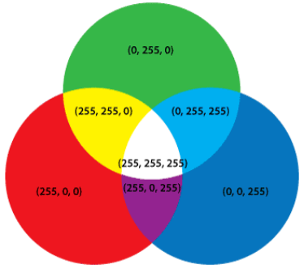
RGB-LED Controlling
1. Introduction
Mixing three basic colours of red, green and blue to emit different colours.

Slide 3
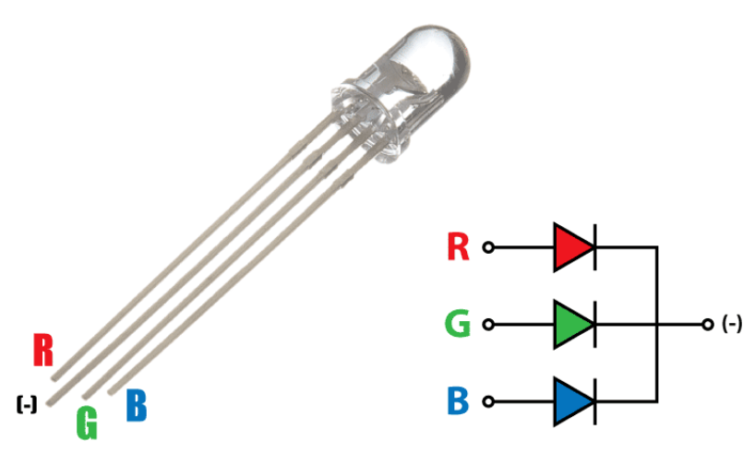
RGB-LED Controlling
RGB-LED has 4 pins. Each of the 3 colours has a lead. It has a shared cathode or anode.

Slide 4
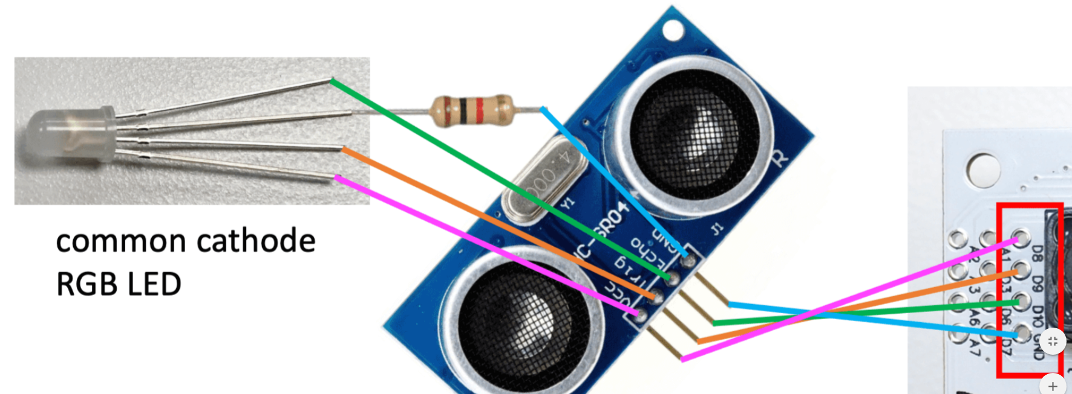
RGB-LED Controlling
2. Operating
Find the IO ports, connect and power on to light RGB-LED.

Slide 5
RGB-LED Controlling
3. Remarks
Start by controlling a single light. The three lights red, green and blue are connected to the IO ports 8, 9, and 10. Pick port 8 to see what colour the light is.
Raise the level at the positive electrode of the LED to +5V. Since the negative electrode has been connected to GND, which is 0V, so that the LED can be lit. Since the voltage of +5V is too high, directly applying the voltage of +5V will burn the LED. So put a resistor in series.

Slide 6
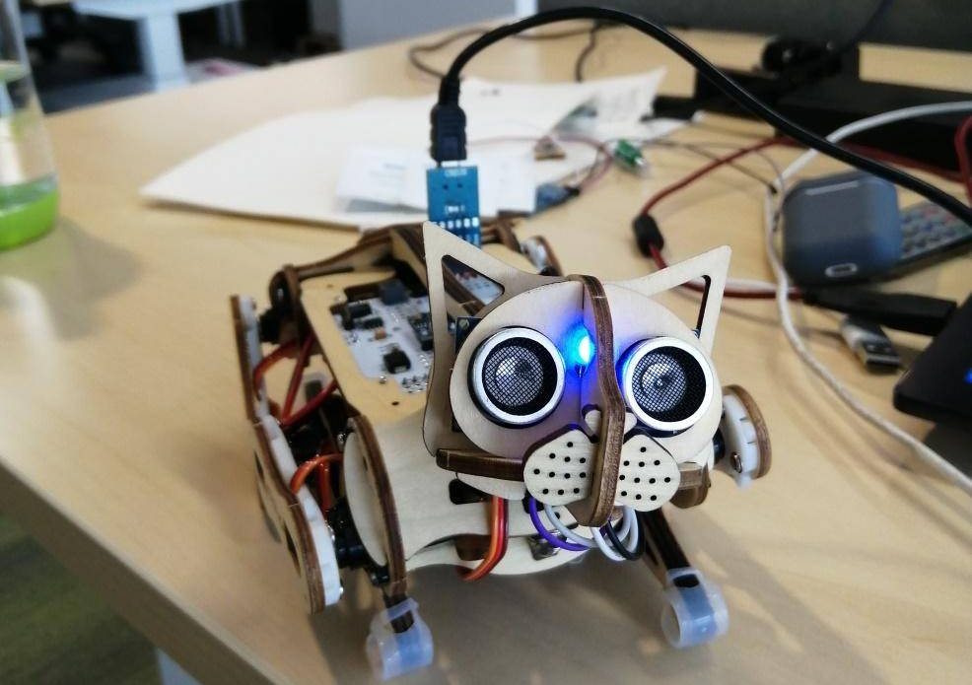
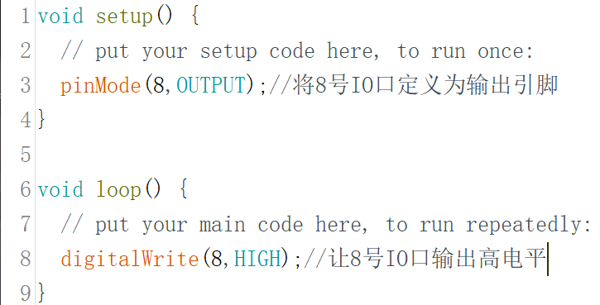
RGB-LED Controlling
4. Coding
Upload

Slide 7
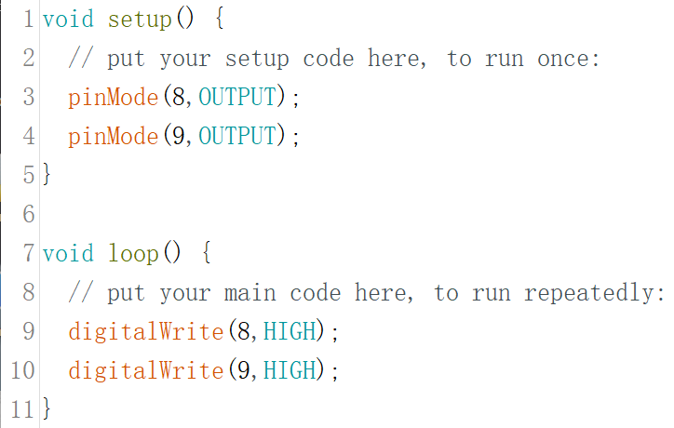
RGB-LED Controlling
To light other two colours, change the 8-IO port to 9 or 10.
To observe the colour after they are mixed, light two or three lights at the same time.

Slide 8
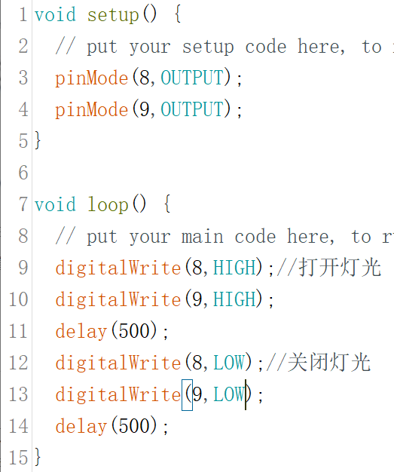
RGB-LED Controlling
5. Flashing
Periodic switching of lights between on and off.

Slide 9

THANK YOU
林天麟 教授
香港中文大学（深圳）
机器人与人工智能实验室
WeChat: tinlunlam

